Slide 1
Video Streaming Applications
Sîrbu Alexandru-Paul 11.01.2024

Slide 2
Agenda
1
2
4
3
Video Streaming Overview
Challenges in Video Streaming
Future Trends & demo
Protocols Used in Video Streaming

Slide 3
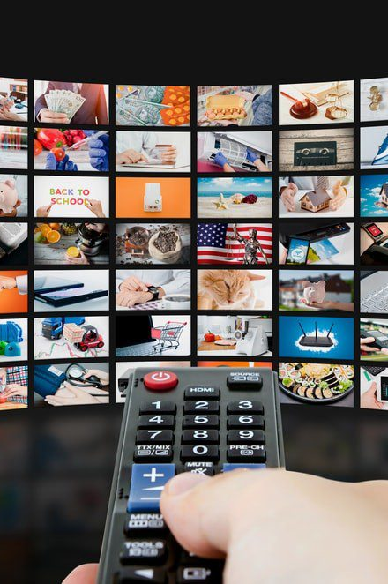
Video Streaming Overview
What is the main difference between traditional video downloading and video streaming, and why is real-time transmission crucial?
What are the main types of Video Streaming?

Slide 4
What is Video Streaming?
Definition: The continuous transmission of video data over the internet for real-time viewing
Real-Time playback
Continuous Transmission
No Permanent Local Copy
Adaptive Streaming
Characteristics
Alternatives?
Traditional downloading (fixed space, quality and no RTA)
Live vs. On-Demand Streaming
Notes:
Importance (business, social, pandemic)

Slide 5
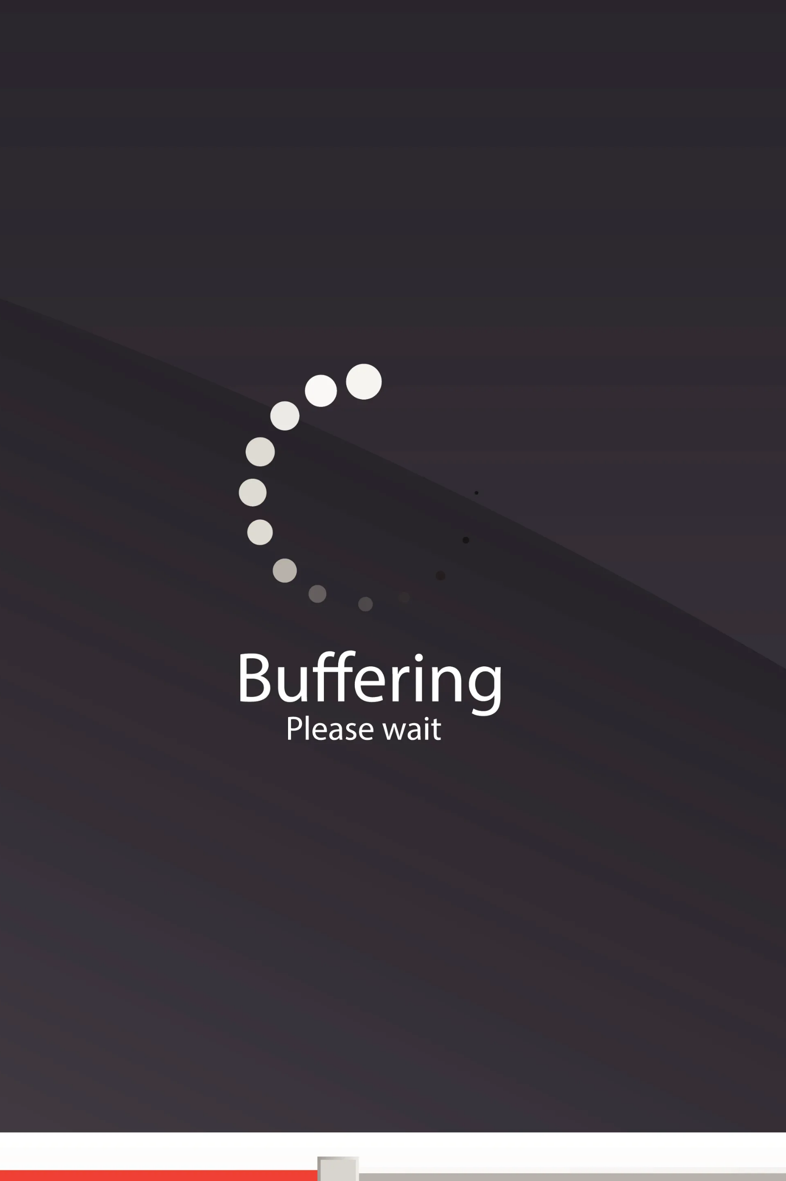
Challenges in Video Streaming
Latency
Buffering

Slide 6
Latency
Definition: Delay between the time a video frame is captured, processed, transmitted, and finally displayed on the viewer's screen.
Importance:
Real-Time Interaction
Video Conferencing
Interactive applications
Adaptive streaming

Slide 7
Buffering
Definition: Buffering is a phenomenon in video streaming where the video playback is temporarily halted to allow the content to load and store in a buffer before continuing to play.
Importance:
User experience
Viewer Perception
For Live Events

Slide 8
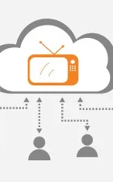
Network Protocols used in Video Streaming
What are the main Network Protocols used in Video Streaming?
What are the advantages and disadvantages and key-decision factors?

Slide 9
HTTP Live Streaming (HLS)
Definition: HLS is an adaptive streaming protocol developed by Apple for delivering audio and video content over the internet.
Compatibility?: HLS is widely supported since it works using HTTP and HTTPS protocols
Advantages:
Reliability
Client-Side Adaptation for Quality
Disadvantages:
Latency
How it works?

Slide 10
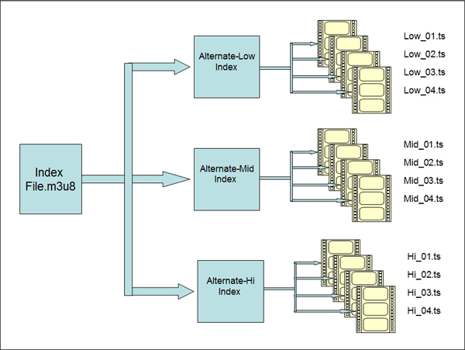
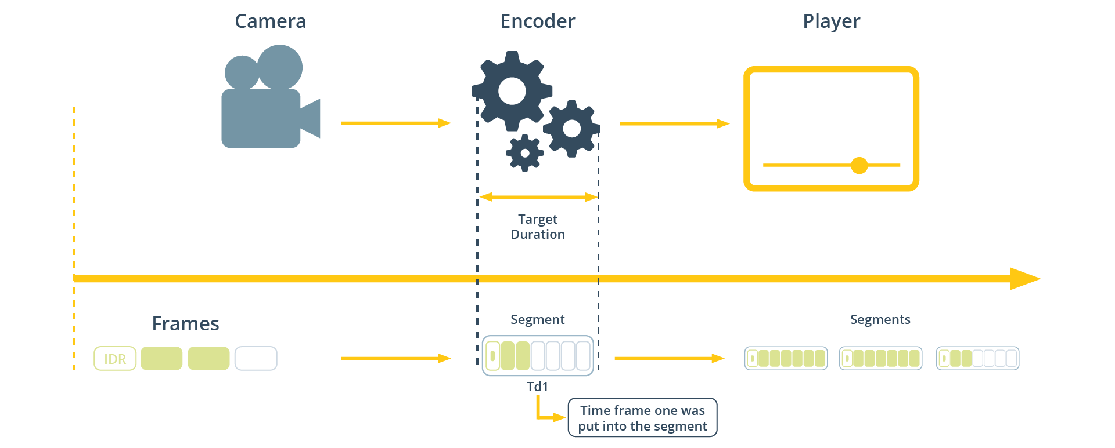

Slide 11
Dynamic Adaptive Streaming over HTTP (DASH)
Definition: DASH is an adaptive streaming protocol that enables the efficient delivery of multimedia content over HTTP.
Compatibility?: DASH is widely supported since it works using HTTP and HTTPS protocols
Advantages:
Interoperability
Client-Side Adaptation for Quality
Supports both Live and On-Demand Streaming
Disadvantages:
Latency
Initial Buffering
Complex MDP Files
How it works?

Slide 12
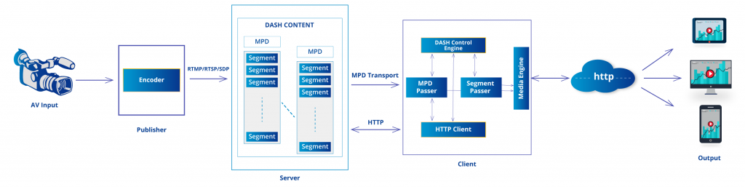

Slide 13
Real Time Streaming Protocol (RTSP)
Definition: RTSP is a network control protocol designed for establishing and controlling media sessions between end devices and servers.
Compatibility?: RTSP is supported by a variety of devices, including IP cameras, media players, and some streaming servers.
Advantages:
Low-Latency
Media Session Control
Disadvantages:
Firewall and NAT Traversal
Stateless Nature
How it works?

Slide 14
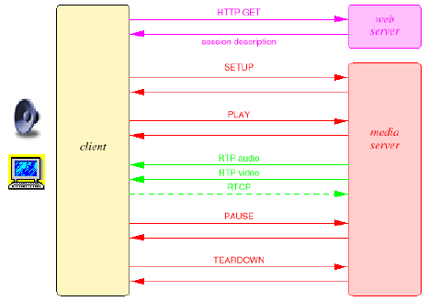

Slide 15
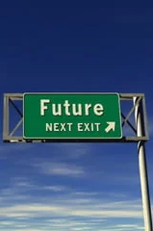
Future Trends & Demo
5G impact
Demo using YouTube

Slide 16
5G impact on Video Streaming
The rollout of 5G networks is expected to significantly impact streaming, enabling higher bandwidth, reduced latency, and improved quality of service.
5G networks can support higher resolutions, frame rates, and better overall streaming quality.

Slide 17
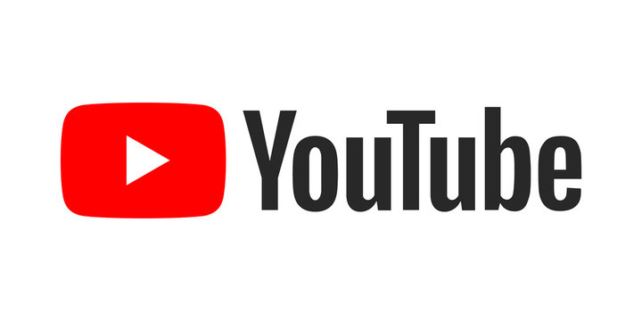
Demo YouTube

Slide 18
Q&A

